Slide 1
53rd high school of athens
Our school

Slide 2
There is the earth…

Slide 3
There is Europe…

Slide 4
There is Greece…

Slide 5
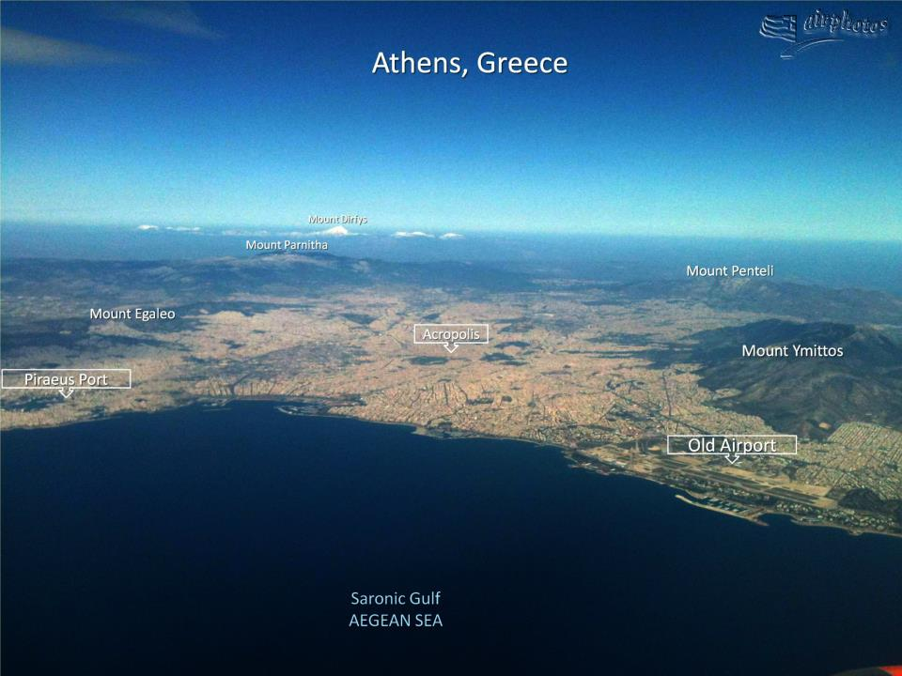
There is Athens…

Slide 6
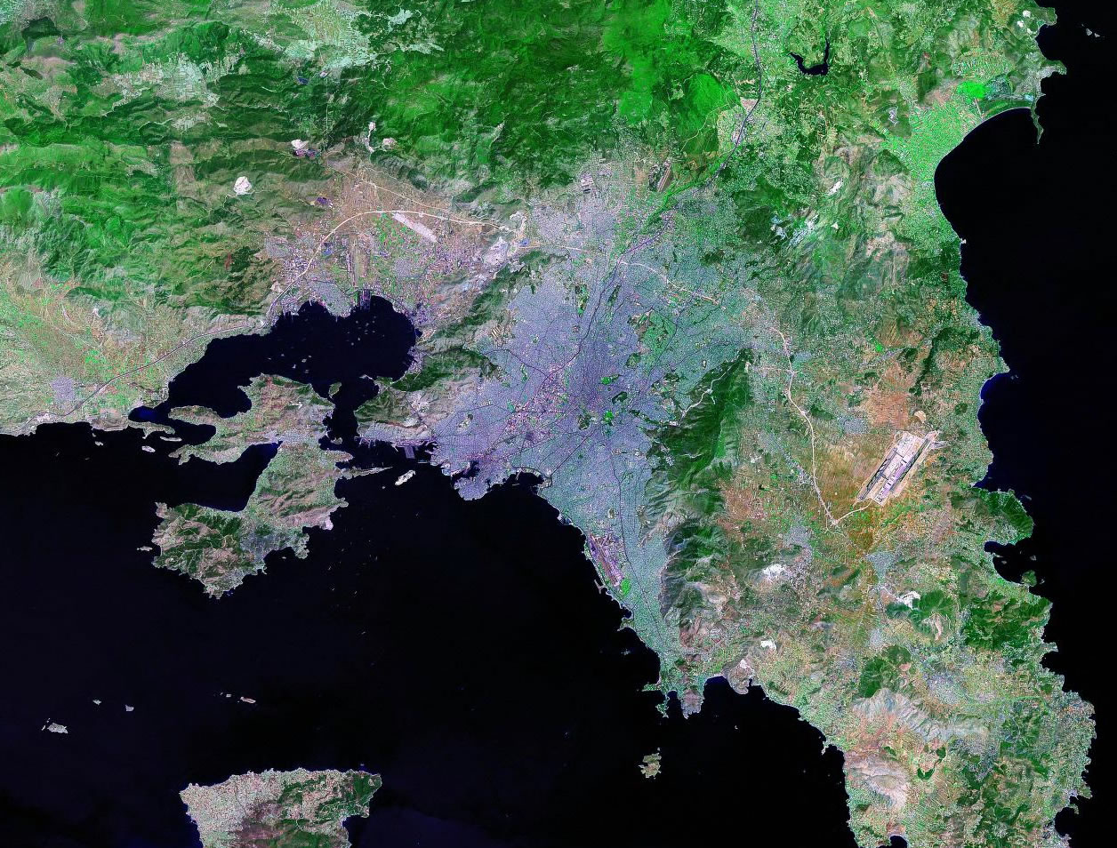
We are the students of the 53rd High School of Athens, Greece, in the southeast corner of our common home, Europe.
sepolia
Acropolis

Slide 7
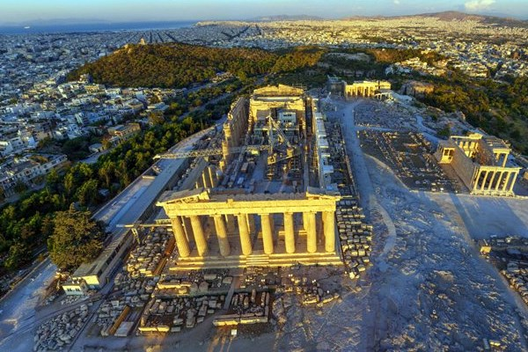
Our school is located in an old neighborhood of the historic city of Athens, worldwide known for being the land of Philosophy, Poetry and Good Arts. The neighborhood is called Sepolia and is located in the northwest of the municipality of Athens about 10 minutes from the Acropolis using the Metro railway.

Slide 8
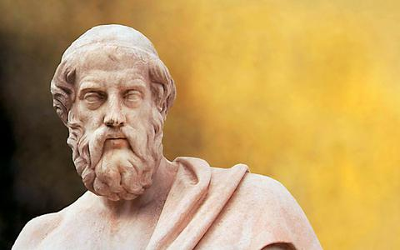
53rd high school
is situated near my Academy too!
plato

Slide 9
School is related to knowledge…

Slide 10
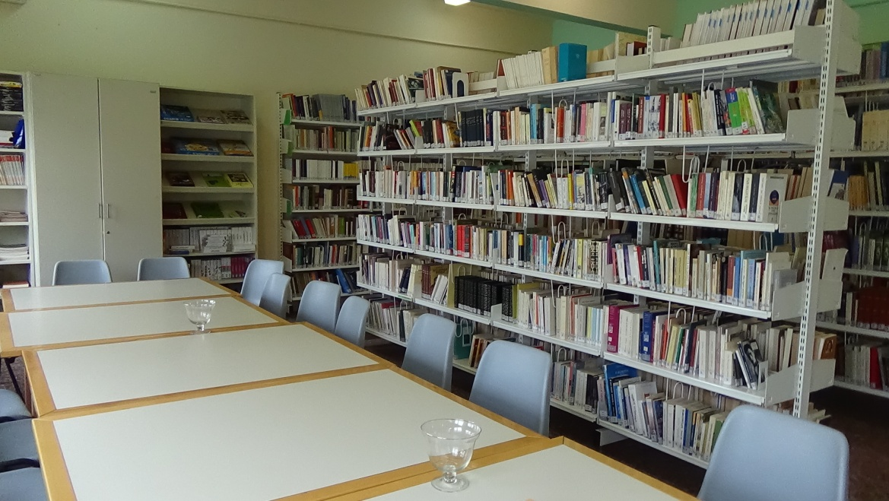
And our school has a library

Slide 11
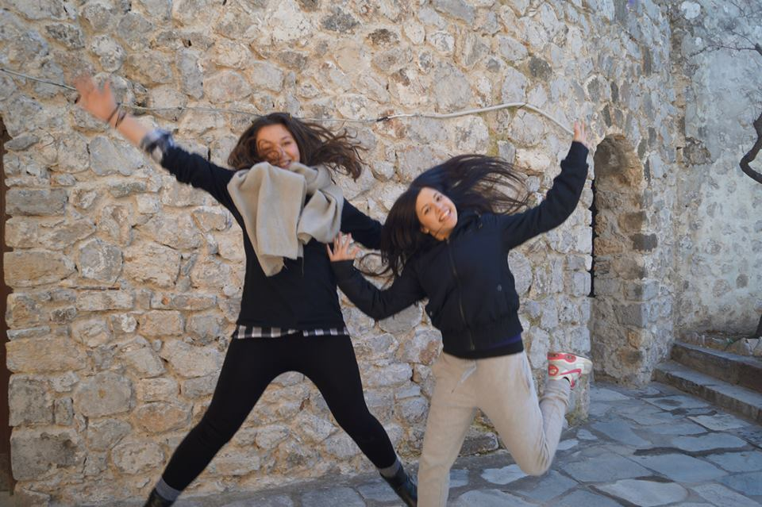
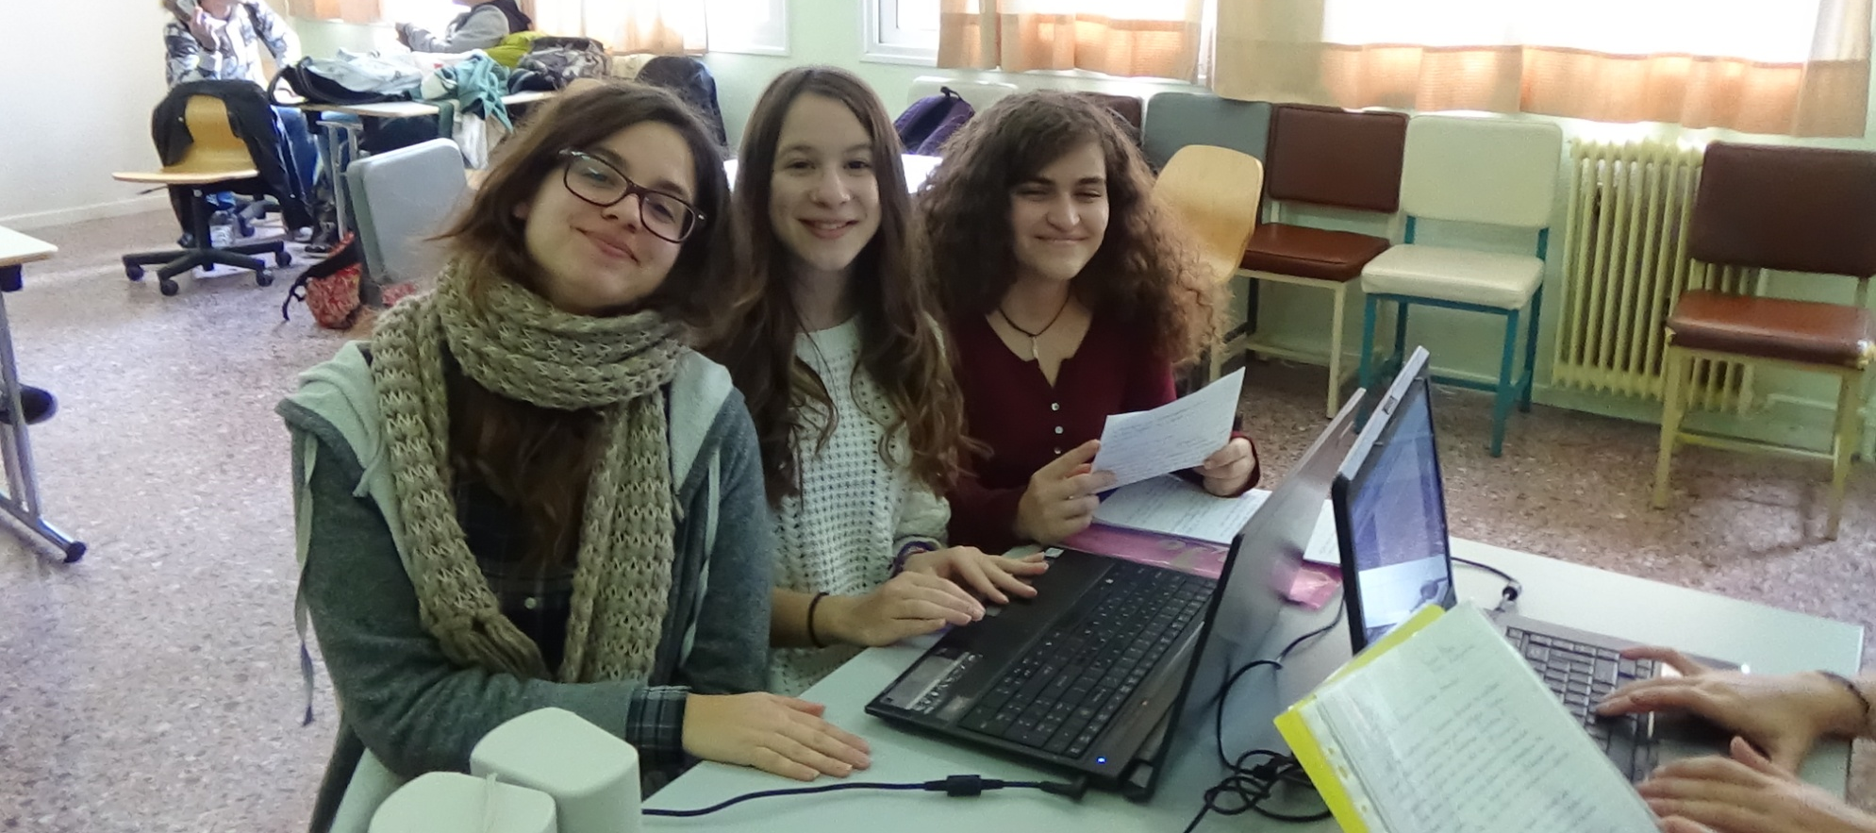
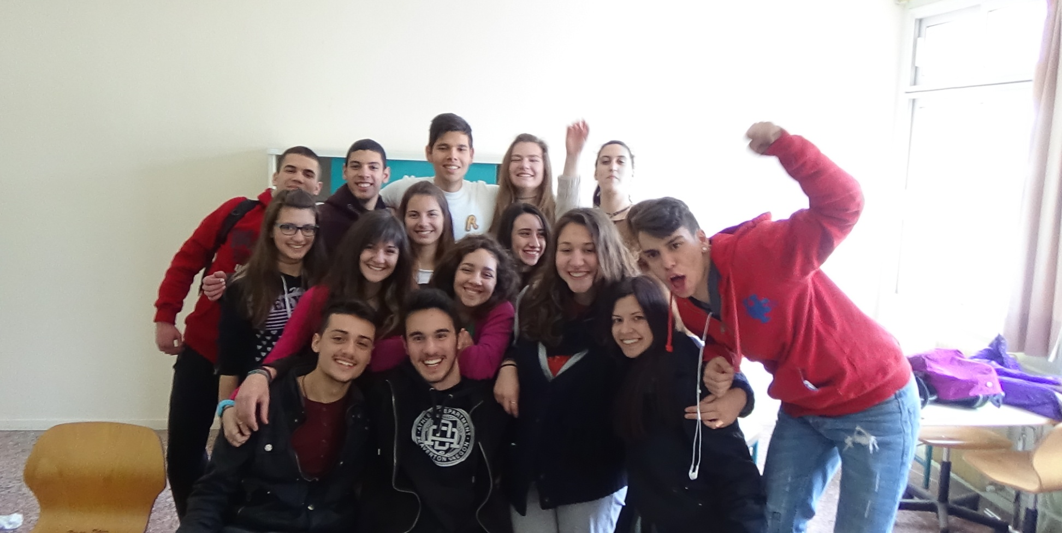
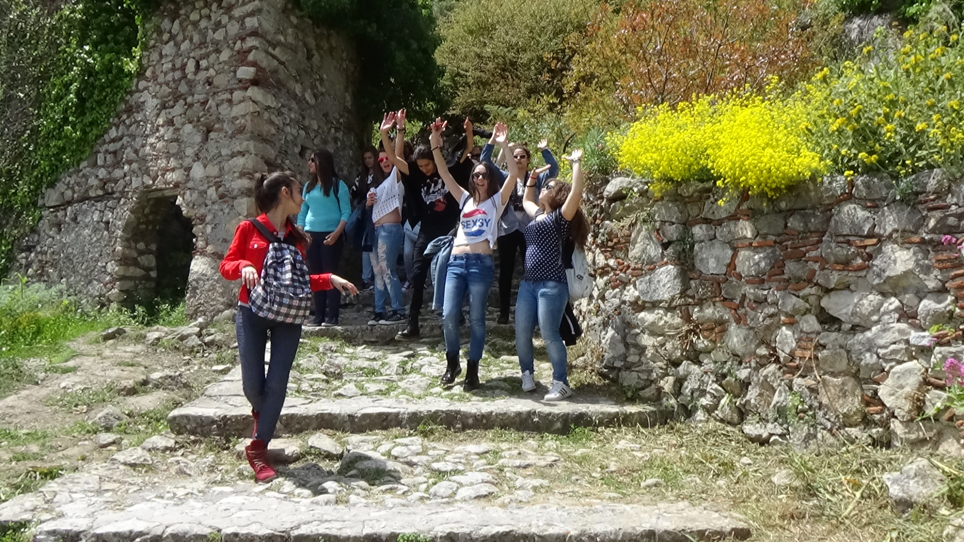
But school means also…
Fun !

Slide 12
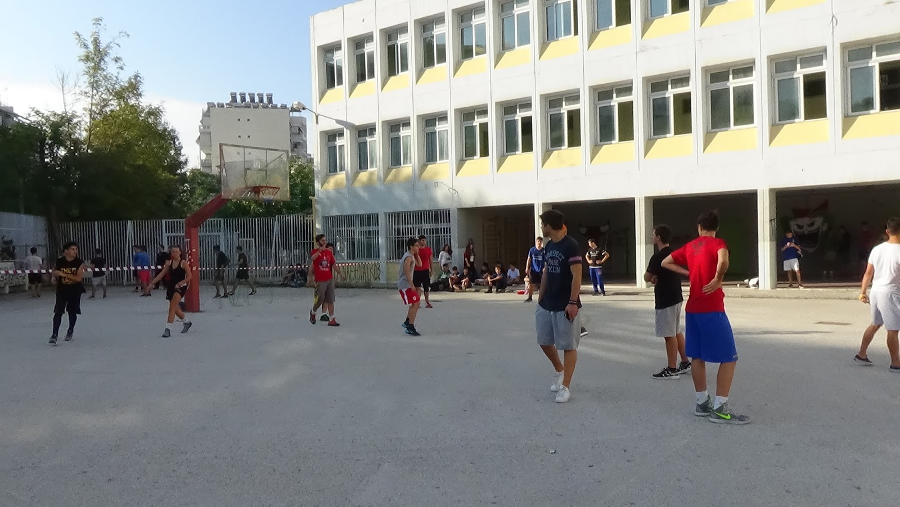
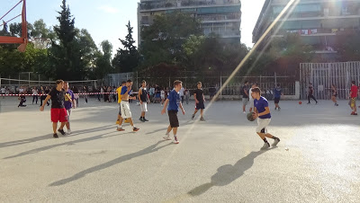
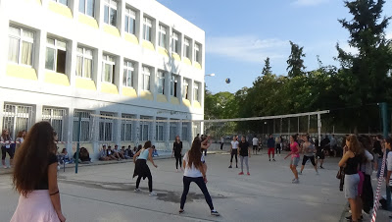
And
sports…

Slide 13
As far as our school is concerned, someone could say that it is a relatively typical secondary education school in terms of the building, the number of students that attend the lessons and the number of teachers that work there.
300 students
28 teachers

Slide 14
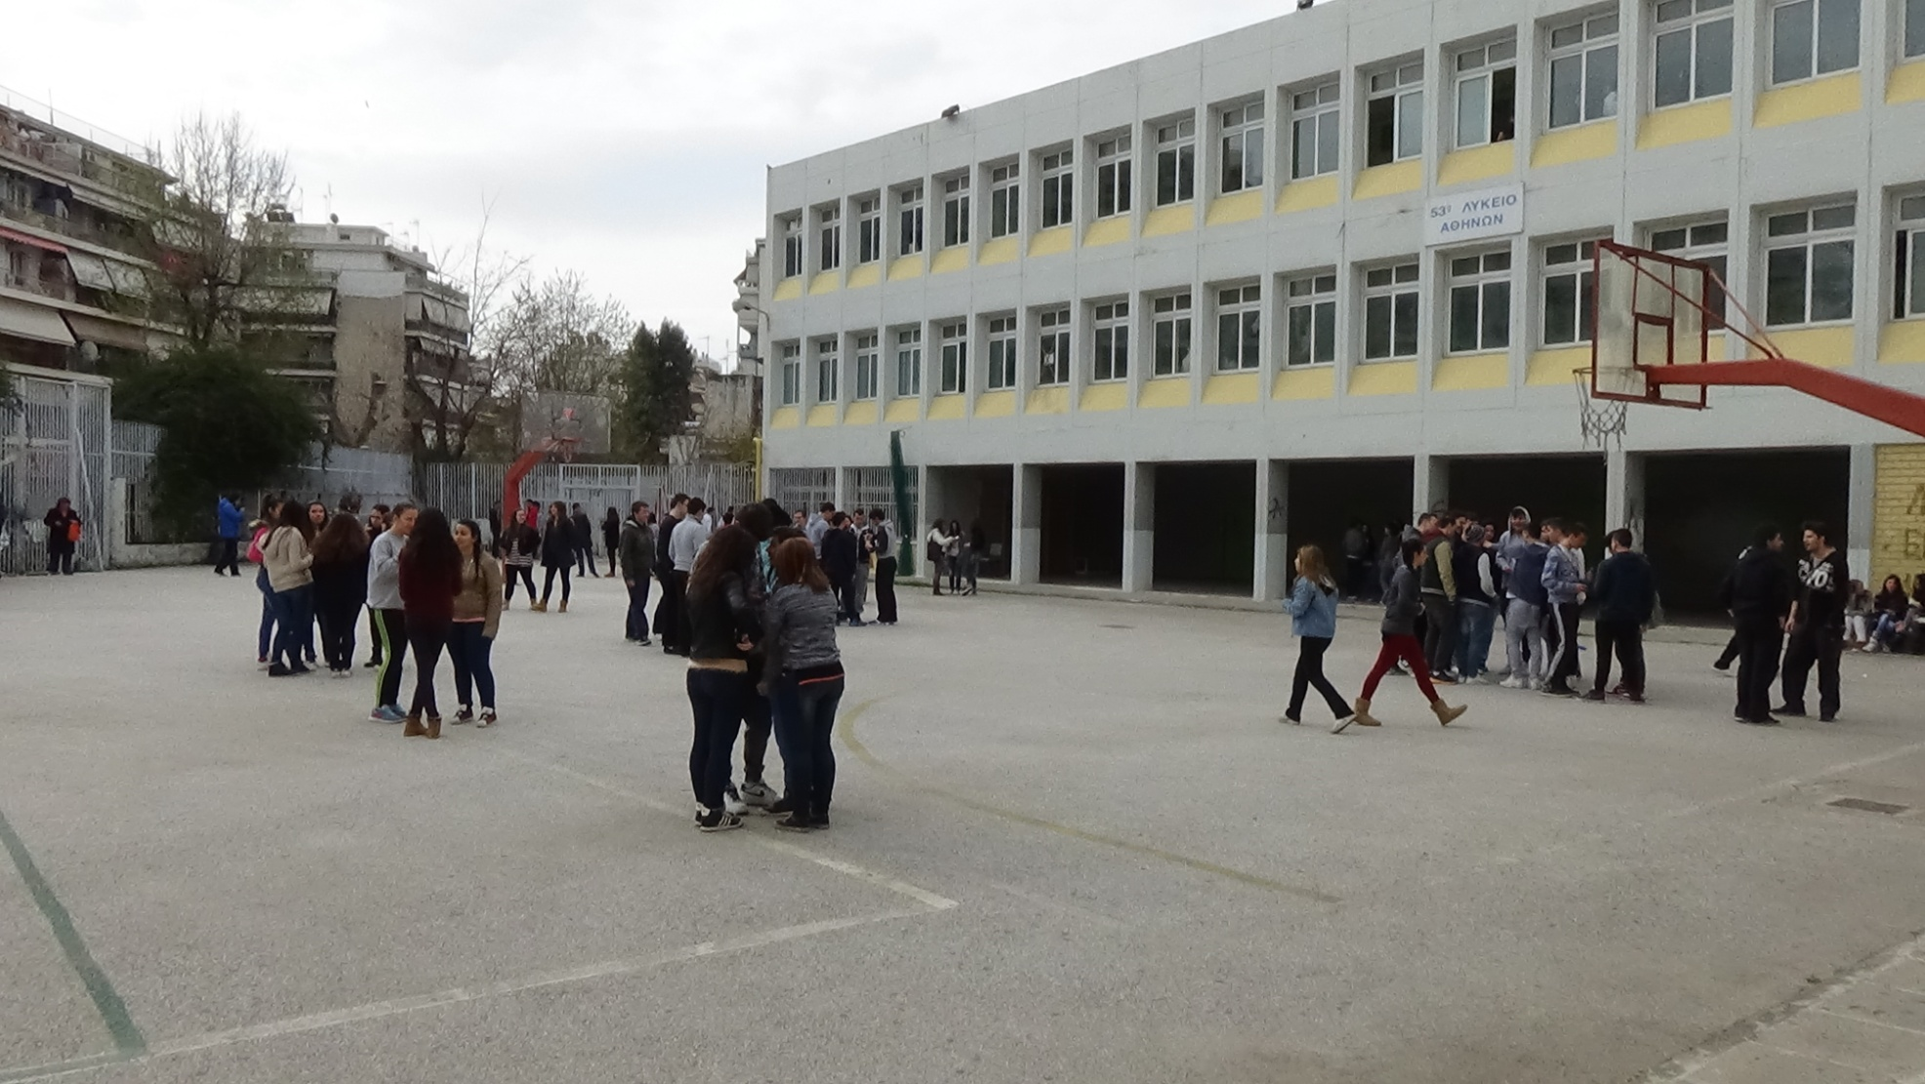
We have a large schoolyard...

Slide 15
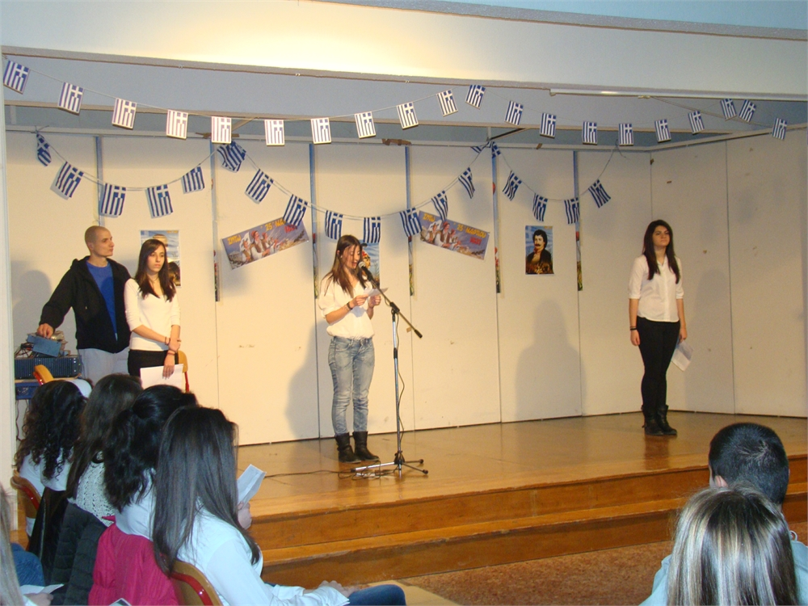
we have also a small auditorium which is used during the school festivals.

Slide 16
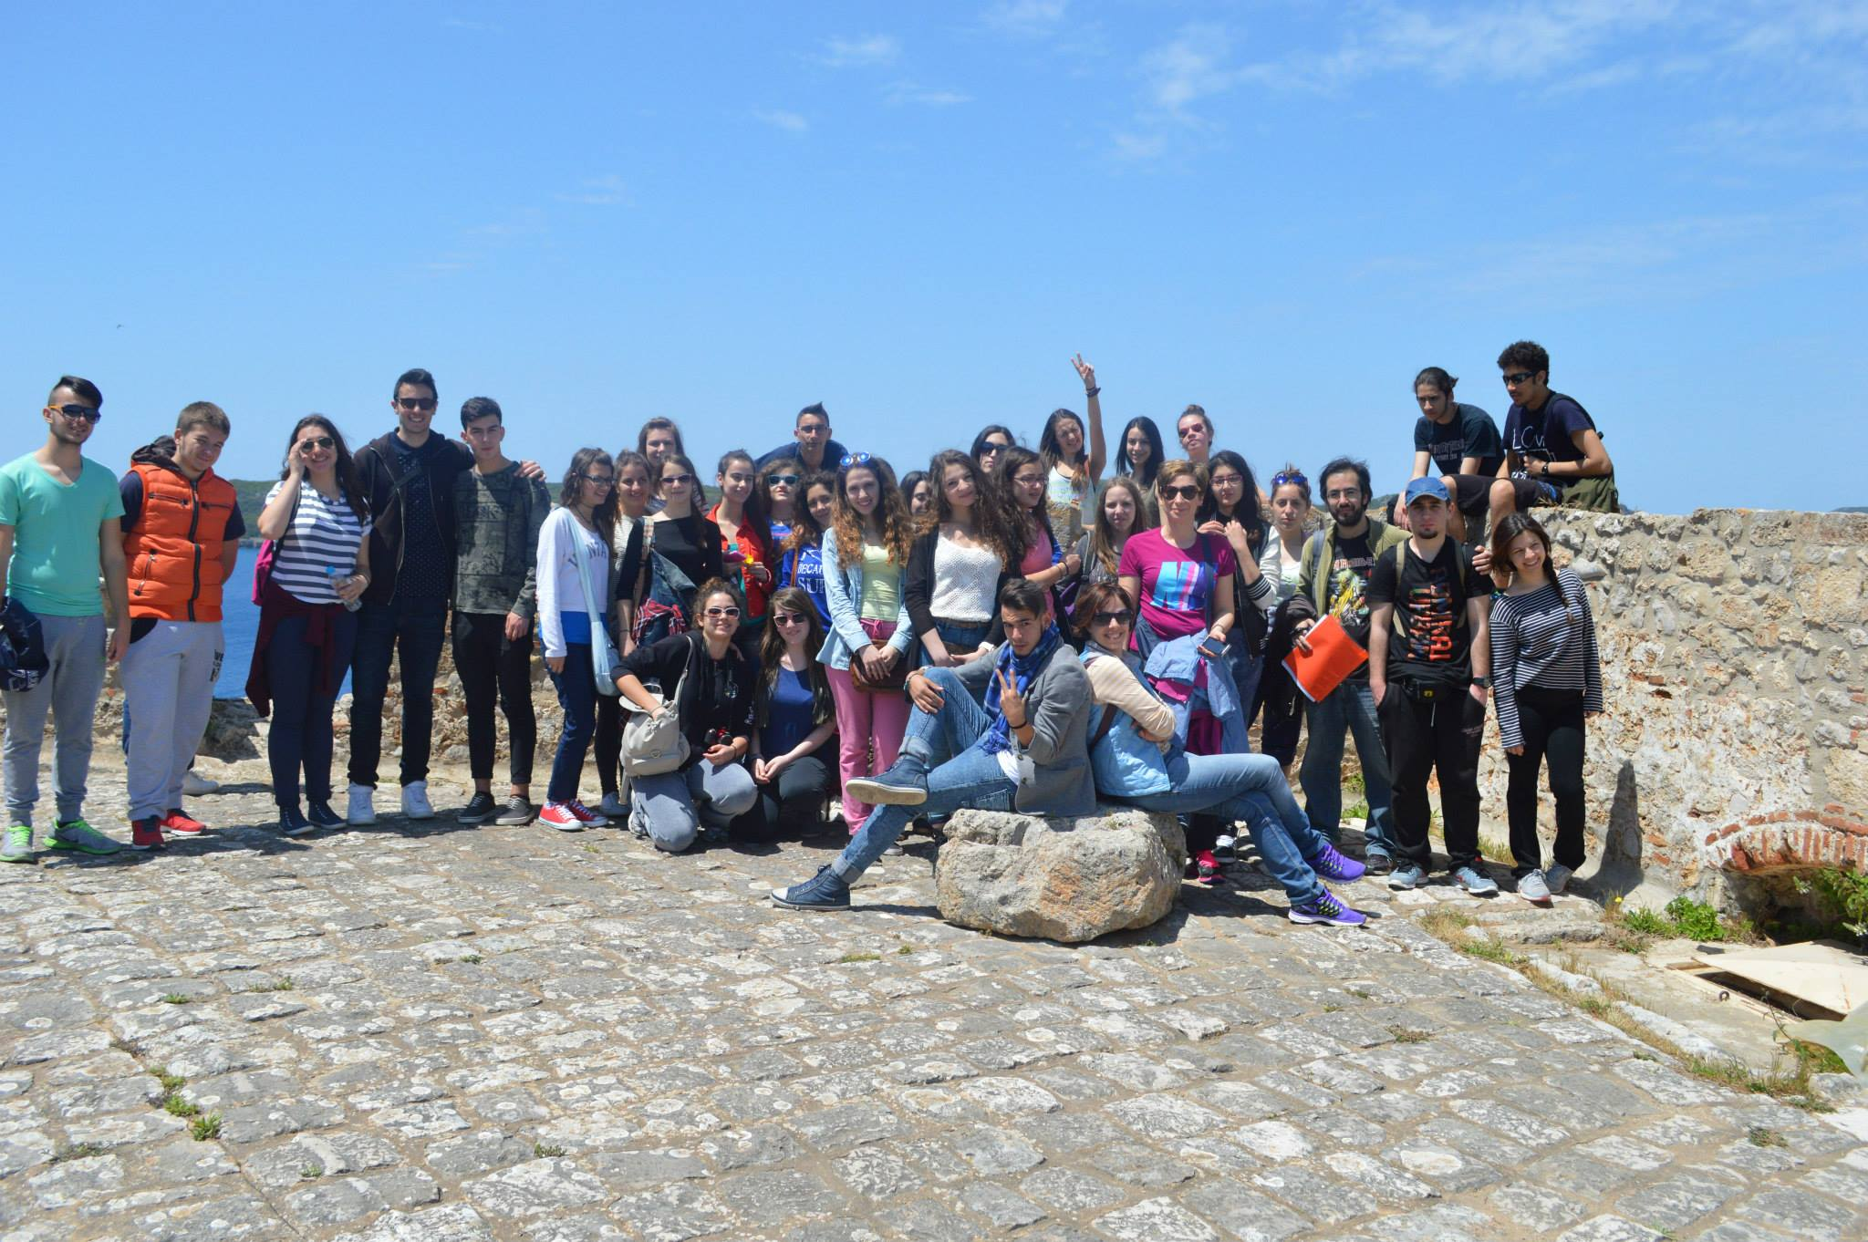
It is fare to say that we very much like taking part in special educational activities such as this Program and other training courses like Environmental Education, even if it means that we should stay further hours at school in order to earn more knowledge and more skills.

Slide 17
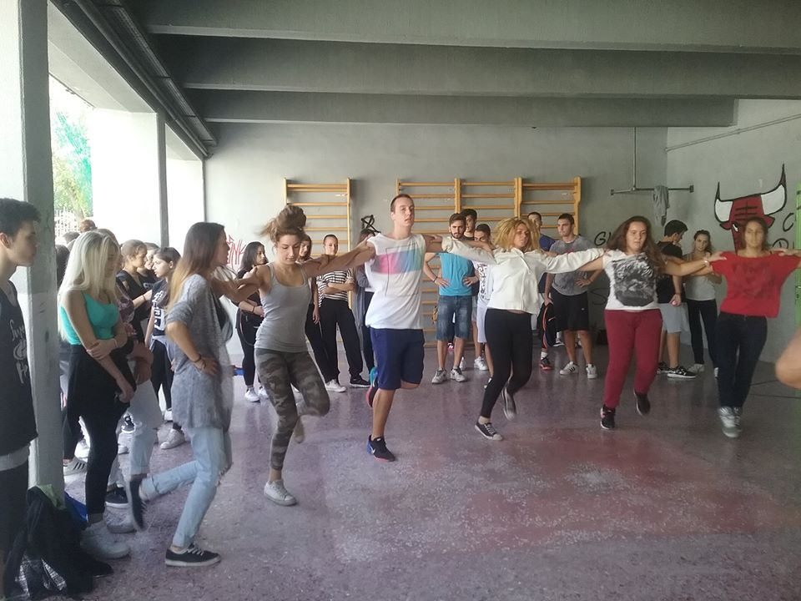
We l♥ve our school…
we all regard our school and this neighborhood as our home

