Slide 1
«VOLONTARIATO»
Volunteer work in Parma
“Doing nothing for others is the undoing of ourselves.” –Horace Mann
ITES G.B. Bodoni

Slide 2
What is a volunteer work?
It’s an initiative that starts from ourselves and we don’t do it to earn money or for job but we only do it in order to make other people feel better.

Slide 3
Who can be a volunteer?
There aren’t any real requirements to be a volunteer: - It’s not required any certification. - It is not necessary to have a high level of education. - It is not required to occupy an important position in the workplace.

Slide 4
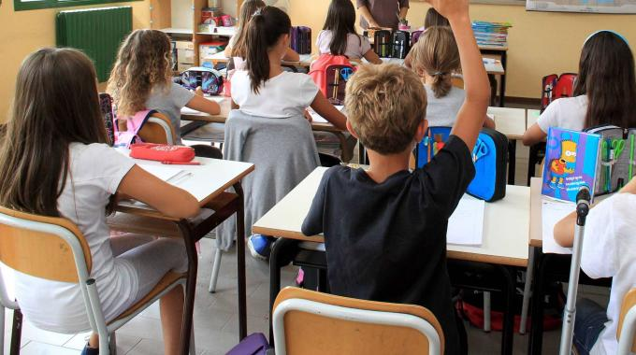
You can get people involved in volunteering:
Thanks to groups of people who explain and inform the citizens about the different existing voluntary initiatives especially in places more frequented by young people, like at school.

Slide 5
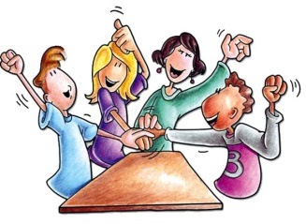
Volunteering activities in our school
Food collection every year for poor people;
Sales of gadgets and decorations for Christmas for associations of charity;
Elder students can help young people (especially from first class) facing troubles with some subjects;
There are some cultural mediators for new students immigrants;

Slide 6
Some associations in Parma where we would really like to work
Croce Rossa;
AmiciCani;
A.S.I.A/VAPA & VAPA;
Caritas;
AVIS;
Giocamico;

Slide 7
Caritas
They promote many activities like donation of goods (clothes or food) to allocate it to people who need them most;
They give home to homeless people;
They also have a canteen where volunteers go everyday to cook meals for people who do not even have money to buy what they need to survive;
Their aim is to help people and communities to develop a form of Christian solidarity.

Slide 8
AVIS
AVIS means «italian association of volunteers of blood»: volunteers are the donors and volunteers are its leaders.
Their aims are: - to meet the growing demand of blood; - to have prepared and tested healthy donors of different blood type; - to get rid of selling blood; - to donate blood for free to all, without discrimination.

Slide 9
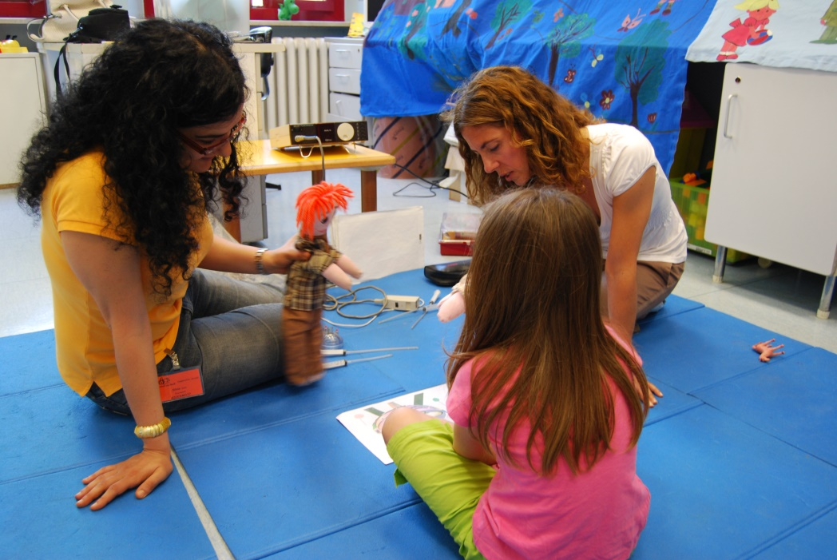
Giocamico
Giocamico plays recreational activity of psycho-pedagogical support for children staying in hospitals.
They believe that it is important for children to have a chance, even in a difficult time like a long or short stay at the hospital, to continue doing those things in everyday’s life that they have always done, to have someone with whom they can be done, and expecially to be in touch with someone that respects their time and their desires.

Slide 10
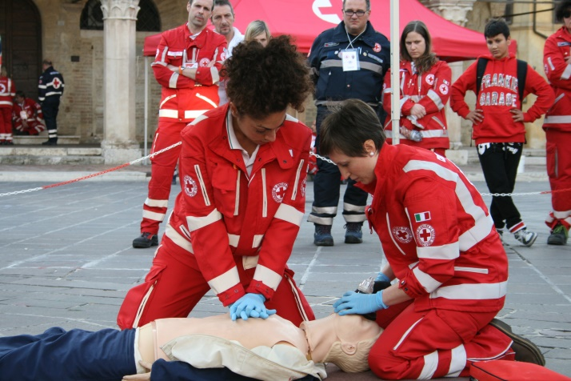
Croce Rossa
It helps and supports people with disabilities and assists people almost dying. Wherever there is pain, especially where human dignity is ignored, where there is someone who needs help or refuge, the Red Cross brings its experience acquired in more than a century of tradition.
Specific aims:
Improving the health status of each individual and community.
Protect life and provide social and health support to every communities.
Building safer communities through health promotion.
Ensure the acquisition of skills by the community to protect their own and others lives.

Slide 11
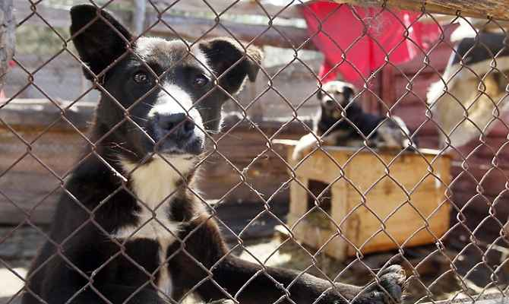
AmiciCani
Their purpose is to find a family to stray and abandoned dogs, always checking carefully the family who takes the responsibility to adopt a dog.
Their main aim is to raise awareness on the problem of stray animals and the pain that dogs generally feel after the abandonment. Obviously their goal is to find them a family that can love them forever and to help other dogs which are still in kennels.

Slide 12
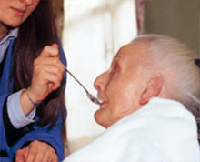
A.S.I.A/A.V.I.A & VAPA
A.S.I.A/A.V.I.A.
The purpose of the association consists of making free transportation for people with disabilities, elderly of purchasing well equipped vans to easily move even people in wheelchairs.
VAPA
Volunteers take on a weekly service for elder people. In rest homes mealtimes are a delicate moment, since there are so many guests who can not take the food themselves, or that someone need to give them a hand. The staff does not always have the opportunity to follow every senior all the time of the meal; on the other hand there are many who may not have the assistance of a family member or an acquaintance.

