Slide 1
VOLUNTEERING IN OUR SCHOOL
We help because we like it!

Slide 2
MOST IMPORTANT PROJECTS
National Food Collections

Slide 3
Christmas Food Collection

Slide 4
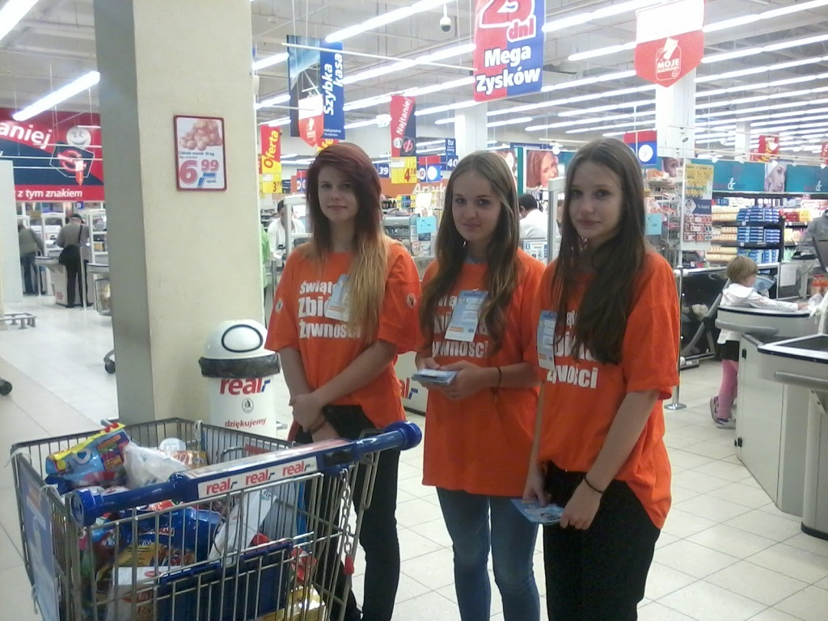
Share a meal!

Slide 5
Easter Food Collection

Slide 6
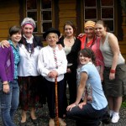
VOLUNTEERING
HELPING THE ELDERLY
CHATTING, DOING HOUSEWORK AND SHOPPING

Slide 7
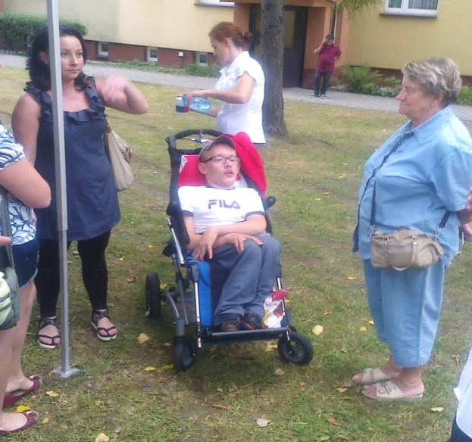
VOLUNTEERING
HELPING THE HANDICAPPED TO SOCIALIZE

Slide 8
VOLUNTEERING
HELPING KIDS WITH SCHOOL SUBJECTS

Slide 9
FIELDS OF HOPE
Fund raising for a hospice

Slide 10
THE END
THANK YOU FOR YOUR ATTENTION☺

