Slide 1
How to make a Business Plan
53rd High School of Athens
Entrepreneurship in Secondary Schools
March, 2017

Slide 2
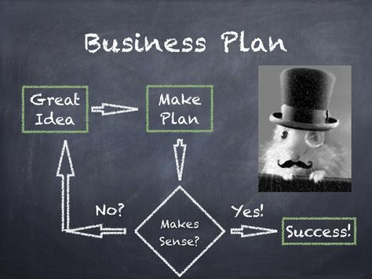
Why is it essential?
It is the description of your business idea and the plan to make it a success.

Slide 3
Cover Page should include:
Title
Business Name
Company Logo
Address
Telephone Number
E-Mail Address
Date

Slide 4
Table of Contents
Quick and easy way to find particular sections of the plan.
All pages of your business plan should be numbered

Slide 5
Executive Summary
The executive summary is what most readers read first.
If it is not good, it may be the last thing they read about your company.
Make sure you answer the following questions:
What is the business about?
Why should someone invest in your product or service?
How will you achieve success?
How much money is required?
Write it after you have
finished the business plan
(as a summary)

Slide 6
Business Description
Answer the following:
Who you are
What will you offer
What market needs you will address
Why your business idea is viable
What you will be selling
Why is it different and better
Why people or businesses will buy it

Slide 7
Mission – Vision – Goals - Values
Start with the mission. Τwo or three sentence description of the purpose of your business and to whom your product or service is targeted.
You can add the vision, goals and the values of your company.

Slide 9
Type of business - Business Name
Small company? International company?
Make your name memorable
Appealing and easy to use names are better
Avoid geographical names

Slide 10
Location
Choose a convenient location for the business.
Don’t forget:
Costs
Competition

Slide 11
Product Description
Stress your products uniqueness
This information sets your product or service apart from your competition.
If the product is not different there must be a reason for customers to buy it.

Slide 12
Company Position
Develop your position by answering the following questions with brief, direct statements:
What is unique about your product or service?
What customer needs does your product fulfill?
How do you want people to view your products or services?
How do your competitors position themselves?

Slide 13
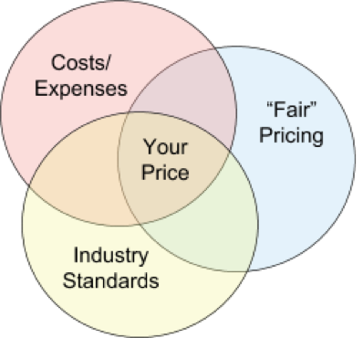
Pricing Strategy
Discuss what you will charge for your product or service and how you derived the price.
Discuss where this pricing strategy places you in the spectrum of the other providers of this product or service.

Slide 14
Customer Profile
It is important to be thorough and specific when creating a description of the target customer for your product or service. This description defines the characteristics of the people you want to sell it to and should indicate, among other things, whether your customers are cost or quality conscious, under what circumstances they buy, and what types of concerns they have.

Slide 15
Customer Profile (continued)
To develop an effective plan based on your customers’ needs and nature, you should be able to answer these questions:
Who are they?
Where are they?
What do they need?
How do they make their buying decisions?
Where do they buy?
How do you reach them with your marketing and sales messages?

Slide 16
Target Market and Demographics
Your target market is a group of customers that a business decided to aim its marketing efforts.
Demographics are the quantifiable statistics of a given population. Example-gender, age, ethnicity, knowledge of languages, disabilities, mobility, home ownership, employment status, and even location.

Slide 17
Competition
The competition section where your products or services fit in the competition environment.
Present a short discussion of each of your primary competitors.
Explain why you think you can capture a share of their business.

Slide 18
Sales Strategy
How you will get customers to buy your products.
Answer following questions:
How you get products to the user?
Will you sell them directly to your customers?
Will you sell online?

Slide 19
Advertising and Promotion
Your advertising and promotions campaign is how you communicate information about your product or service.
This section should include a description of all advertising vehicles you plan to use-newspapers, magazines, radio & TV, sales/promotional materials, package design, facebook etc.

Slide 20
Slogan
Come up with a slogan for your company .

Slide 21
Management - Ownership
A short section on who owns and controls your company will help readers derive a better understanding of who will make decisions.
Is it a sole proprietorship, partnership, or a corporation.

Slide 22
Financial information
Make sure to include:
How much money you need
How much money you have
If you can borrow the rest of the money
You forecasts for the first 2-3 years

Slide 23
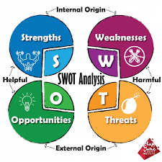
SWOT Analysis

Slide 24
Good luck with your business plan!

