Slide 1
The Financial Section
… of a Business Plan

Slide 2
Is it important?
The most important section
Some people read this section first
It shows whether the business plan will result in success (profits) or not

Slide 3
Should include:
Initial capital
Investment cost
Costs
Revenues
Profit

Slide 4
Initial capital:
How much money you already have available for the business.
They may be:
Your money from personal savings
A loan
A grant from the government
Money from investors

Slide 5
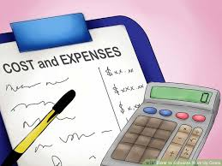
Investment and start-up costs:
How much money you need to start the business.
Start-up costs must not be forgotten!
Building
Equipment
Employees
Promotion

Slide 6
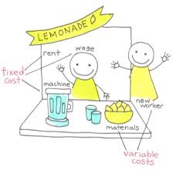
Let’s talk about costs:
Fixed costs
They stay the same over the year.
They don’t change if the sales are higher or lower.
Variable costs
They change as the output change.
If the company sells more products they increase.
Some costs are considered to be mixed because they
contain both fixed and variable elements

Slide 7
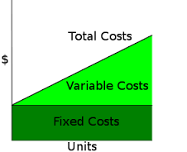
Examples of costs in a company:
Fixed costs
Rent
Equipment
Salaries
Variable costs
Raw materials
Delivery costs
Mixed costs
Utility costs

Slide 8
Facts about costs:
All companies try to minimize costs
Some companies outsource services in order to have lower costs (i.e. cleaning)
Service companies don’t need to buy raw materials for products (fewer costs)

Slide 9
Revenues:
How much money a company receives from the sales
Take into consideration the sales and the price

Slide 10
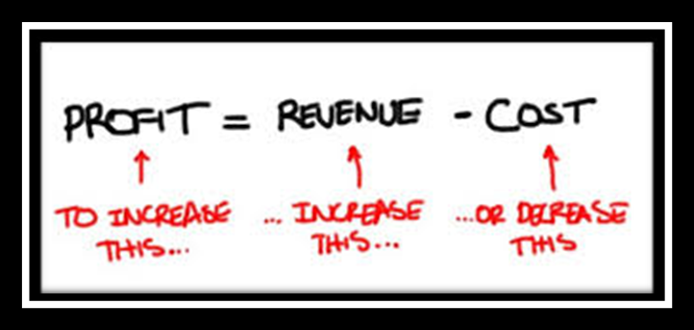
Profits:

Slide 11
To sum up:
Estimate the money you need to start
Calculate the money you have or can find
Think about the costs when you start producing
Forecast sales and estimate revenues
Is there any profit?

